Slide 1

ISP-CWP
Intergovernmental Science-Policy Panel on Chemicals, Waste and Pollution
1 February 2026
Introducing the Intergovernmental Science-Policy Panel on Chemicals, Waste and Pollution (ISP-CWP)
Informal stakeholder meeting
www.unep.org
Interim secretariat of the Intergovernmental Science-Policy Panel on Chemicals, Waste and Pollution (ISP-CWP)

Slide 2


Intergovernmental Science-Policy Panel on Chemicals, Waste and Pollution (ISP-CWP)
Panel’s establishment
Foundational document of the Panel
Road to the first session of the Plenary
Sign up for ISP-CWP updates at: https://www.unep.org/isp-cwp/about

Slide 3
UNEA resolution 5/8
Adopted on 2 March 2022
Decided that a science-policy panel should be established to contribute further to the sound management of chemicals and waste and prevent pollution
Convened an ad hoc open-ended working group (OEWG) to prepare proposals for the science-policy panel
Requested the UNEP Executive Director to convene an intergovernmental meeting to consider the establishment of the science-policy panel
Intergovernmental Science-Policy Panel on Chemicals, Waste and Pollution
ISP-CWP

Slide 4
Road to the Intergovernmental Science-Policy Panel on Chemicals, Waste and Pollution
Sessions of the ad hoc open-ended working group and the Intergovernmental Meeting
2 March 2022: UNEA decided that a science-policy panel should be established to advance the sound management of chemicals and waste and prevent pollution (UNEA resolution 5/8)
Dec. 2023: Second session of the OEWG, held in Nairobi, Kenya (OEWG 2)
20 June 2025: Intergovernmental Science-Policy Panel on Chemicals, Waste and Pollution established at the Intergovernmental Meeting (IM) held in Punta del Este, Uruguay
2022
2023
2024
2025
Intergovernmental Science-Policy Panel on Chemicals, Waste and Pollution
ISP-CWP
October 2022 and January 2023: The first session of the OEWG, held in two parts, online and in Bangkok, Thailand (OEWG 1.1 & 1.2)
June 2024 and June 2025: The third session of the OEWG held in two parts in Geneva, Switzerland, and in Punta del Este, Uruguay (OEWG 3.1 & 3.2)

Slide 5
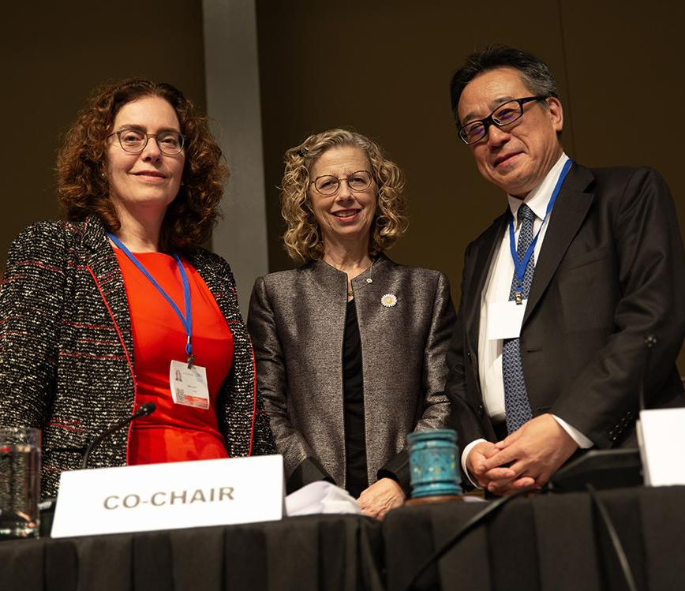

The Intergovernmental Science-Policy Panel on Chemicals, Waste and Pollution established in Punta del Este, Urugay, on 20 June 2025
Intergovernmental meeting Co-Chair Laura Dupuy (Uruguay), UNEP Executive Director Inger Andersen, and intergovernmental meeting Co-Chair Yutaka Matsuzawa (Japan) Photo by IISD/ENB - Angeles Estrada Vigil

Slide 6
Foundational document
The Intergovernmental Meeting decides to establish the Panel, as specified in the foundational document set out in the annex to the decision (Decision IM/1)
Key elements:
Scope, objective and functions
Operating principles and approaches
Institutional arrangements
Evaluation of the Panel’s effectiveness
Intergovernmental Science-Policy Panel on Chemicals, Waste and Pollution
ISP-CWP

Slide 7
(b) Conducting assessments
The objective of the Panel is to strengthen the science-policy interface to contribute to the sound management of chemicals and waste and pollution prevention
(c) Providing up-to-date and relevant information
(a) Undertaking horizon scanning
Functions
(e) Integrating capacity building
(d) Facilitating information Sharing

Slide 8
Operating principles and approaches
In carrying out its work, including:
Being scientifically independent, and ensuring credibility and legitimacy including through peer review of its work.
Upholding consensus in its decision-making processes.
Respecting independence of science, while ensuring differing scientific views are adequately reflected by the Panel.
Ensuring impartiality and transparency …
Producing deliverables that are policy relevant without being policy prescriptive, and, scientifically robust, unbiased and accessible ...
Intergovernmental Science-Policy Panel on Chemicals, Waste and Pollution
ISP-CWP

Slide 9
Institutional arrangements: Plenary
Membership
The Plenary is the governing and decision-making body of the Panel.
Membership of the Plenary is open to States Members of the UN and UN non-member observer states having expressed their intent to be a member of the Panel
Open to participation as observers by any State not a member of the Panel, any United Nations entity and any other body, organization or agency […] qualified in matters covered by the Panel, and which has informed the Secretariat of its wish to be represented, subject to the rules of procedure and subject to two specific provisions …
Intergovernmental Science-Policy Panel on Chemicals, Waste and Pollution
ISP-CWP

Slide 10
Institutional arrangements: Plenary
Functions
(a) Adopting the Panel’s work programme to deliver on each of its functions; …
(e) Electing the Bureau, the members of the Interdisciplinary Expert Committee and other subsidiary bodies, in accordance with the rules of procedure;
(f) Establishing subsidiary bodies, in accordance with the rules of procedure. …
(h) Approving a budget and overseeing the allocation of the Trust Fund. …
(k) Adopting the rules of procedure by consensus. …
Intergovernmental Science-Policy Panel on Chemicals, Waste and Pollution
ISP-CWP

Slide 11
Institutional arrangements: Bureau
The Bureau is comprised of two members from each of the five United Nations regional groups and elected by the Plenary, including one chair and nine vice chairs.
Members of the Bureau are selected for their expertise relevant to the functions of the Bureau.
Intergovernmental Science-Policy Panel on Chemicals, Waste and Pollution
ISP-CWP

Slide 12
Institutional arrangements: Interdisciplinary Expert Panel (IEC)
IEC will be comprised of experts from each of the five United Nations regional groups, with due regard to equitable geographical representation.
Nominated by regions and elected by the Plenary
Selected for their expertise, including scientific, socioeconomic, and technical expertise, and knowledge of the main elements of Panel’s work
Intergovernmental Science-Policy Panel on Chemicals, Waste and Pollution
ISP-CWP

Slide 13
Institutional arrangements: Secretariat, financial arrangements and partnerships
A Trust Fund will be established and the Plenary will decide on the financial procedures.
UNEP will provide the secretariat for the Panel, which will be in a single location based on offers from members.
The Plenary will request the Secretariat to develop a proposal on establishing different types of partnerships to be considered by the Panel.
Intergovernmental Science-Policy Panel on Chemicals, Waste and Pollution
ISP-CWP

Slide 14
Stakeholder Engagement in the Panel’s Work
Pending decisions by the initial session of the Plenary:
Raise awareness of the Panel among your peers and networks
Respond to calls for submissions with (joint) inputs, if so requested
Participate in the Plenary as observers
Participate as authors, information and data contributors, or reviewers in the Panel’s work (once the work programme has been agreed)
Translate and disseminate the Panel’s outputs
Foster uptake of the deliverables by policy- and decision-makers
Produce and publish research and outputs that may inform the Panel’s work
Intergovernmental Science-Policy Panel on Chemicals, Waste and Pollution
ISP-CWP

Slide 15
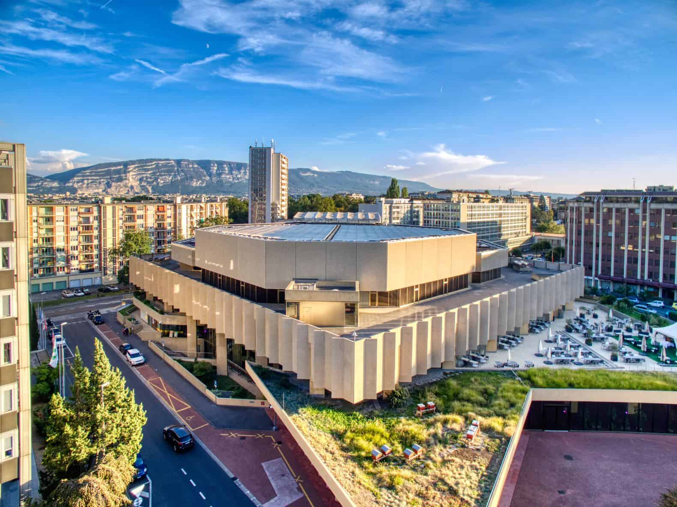
First session of the Plenary of the Intergovernmental Science-Policy Panel on Chemicals, Waste and Pollution (ISP-CWP P1)
2–6 February 2026
International Conference Centre Geneva (CICG),
Geneva, Switzerland
1 February 2026 Regional and stakeholder meetings
Access event website at: unep.org/isp-cwp/plenary
Questions? Contact us at: isp-cwp@un.org

Slide 16
ISP-CWP P1: Provisional agenda
UNEP/ISP-CWP.1/1
Opening of the session
Organizational matters
Credentials of representatives
Report on activities of the interim secretariat
Operational arrangements of the Panel
Financial and budgetary arrangements of the Panel
Provisional agenda, dates and venue of the next session of the Plenary.
Adoption of decisions and the report of the session
Any other matters
Closure of the session
Intergovernmental Science-Policy Panel on Chemicals, Waste and Pollution
ISP-CWP

Slide 17
Scenario note: Guide to ISP-CWP Plenary 1
UNEP/ISP-CWP.1/INF1
Background and context: Recap of decision by Intergovernmental Meeting:
Foundational document of the Panel: set out in the annex to decision IM/1, on the establishment of the ISP-CWP, adopted at the IM.
In decision IM/2, on recommendations for consideration by the Plenary at its first session, the intergovernmental meeting (1) recommended draft rules of procedure set out in annex I for consideration and possible adoption by the first Plenary session, and (2) transmitted other documents in annexes II–IV for further consideration by P1.
In decision IM/3, on arrangements for the interim period, UNEP’s Executive Director was requested to provide the interim secretariat
Intergovernmental Science-Policy Panel on Chemicals, Waste and Pollution
ISP-CWP

Slide 18
Expected outcomes ISP-CWP Plenary 1
UNEP/ISP-CWP.1/INF1
Expectations include that by the closure the first Plenary session will have:
Elected the Chair and the first Bureau of the Panel;
Adopted the rules of procedure for the Plenary;
Designated the physical location of the secretariat of the Panel;
Requested the establishment of a trust fund;
Agreed on intersessional work and preparations for the second session of the Plenary, including to:
Develop a proposal on establishing different types of partnerships;
Pursue consideration of remaining procedures and policies intersessionally;
f) Decided on the provisional agenda, dates and venue of next Plenary session
g) Adopted the draft report of the first session of the Plenary.
Intergovernmental Science-Policy Panel on Chemicals, Waste and Pollution
ISP-CWP

Slide 19

Thank you
Tessa Goverse
Principal Coordinator
isp-cwp@un.org
United Nations Avenue, Gigiri
PO Box 30552 – 00100 GPO Nairobi, Kenya
www.unep.org/isp-cwp

